Slide 1

INFO 5709 Final Project Data Visualization & Communication
Pavithra Vonteddu

Slide 2
Introduction to Dataset
This Dataset has been gathered from the U.S. Dept. of Education College scorecard.
The Dataset “MERGER2018-19” has 1986 Columns and 6806 rows.
We had a Data Dictionary file to understand every column and perform better in the EDA.

Slide 3
Data Preprocessing and EDA
In the Dataset, we had modified the columns based on the given index and categorized Columns like: ST_FIPS – States(58 Values), CONTROL – Sector (3 values) and PREDDEG – Predominant Degree(5 values).
Checking all the missing values and filtering the data based on the requirements and few plot diagrams to check how the dataset is arranged.
I have filtered the respective columns with categorized columns along with College students with various races/Ethnicity, Latitude and Longitude.
After processing the shape of the dataset is 6806 rows and 14 columns.

Slide 4
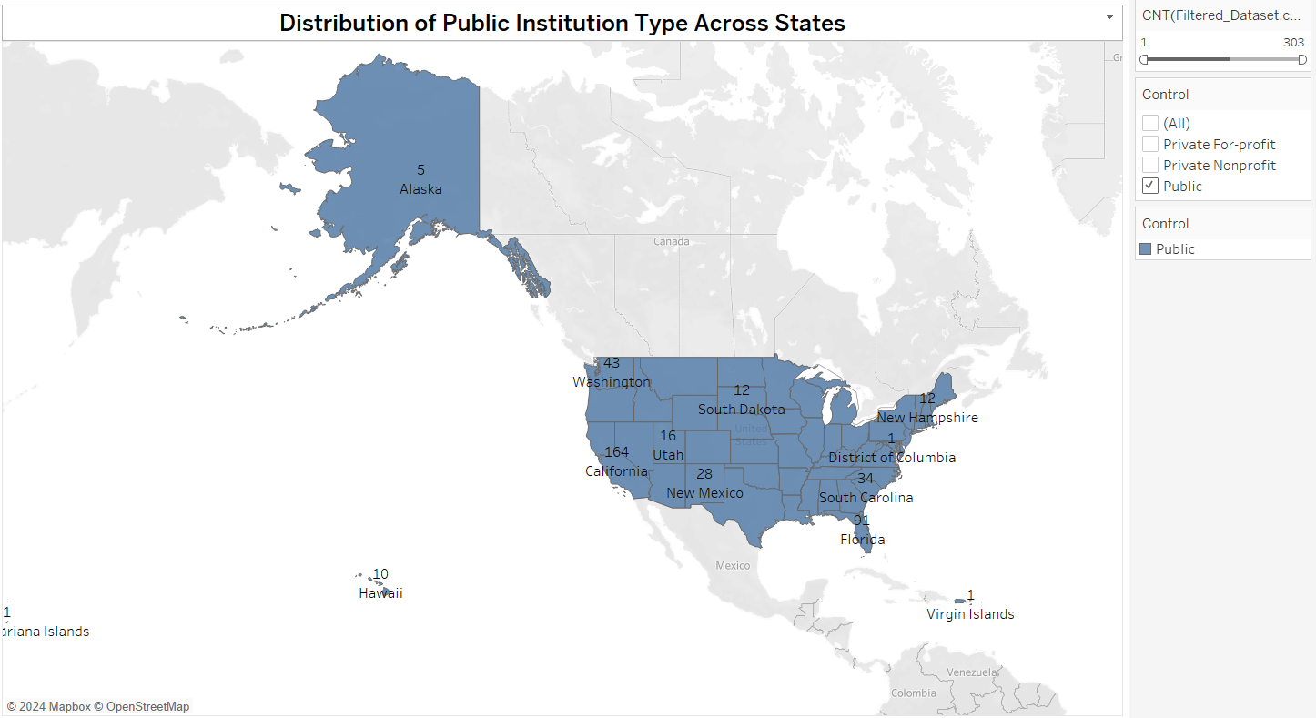
1. Which State has the highest number of entries for public Control.
Ans: California

Slide 5
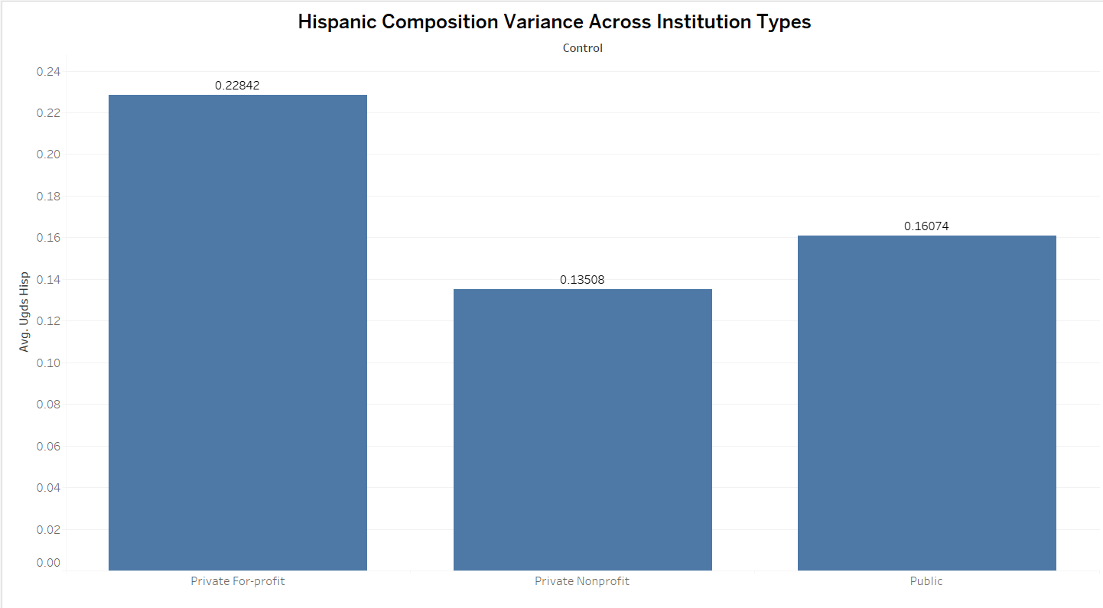
2. In Hispanic race which control has the highest average
Ans: Private For-profit

Slide 6
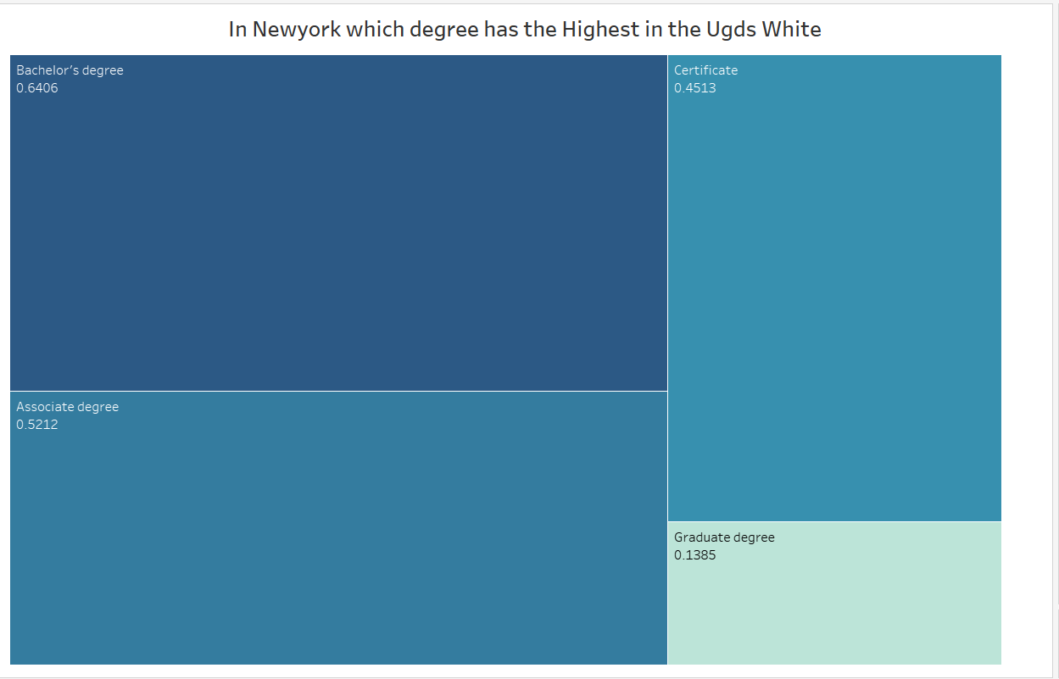
3.In New York state which degree has the highest average among Ugds White.
Ans: Bachelor’s degree

Slide 7
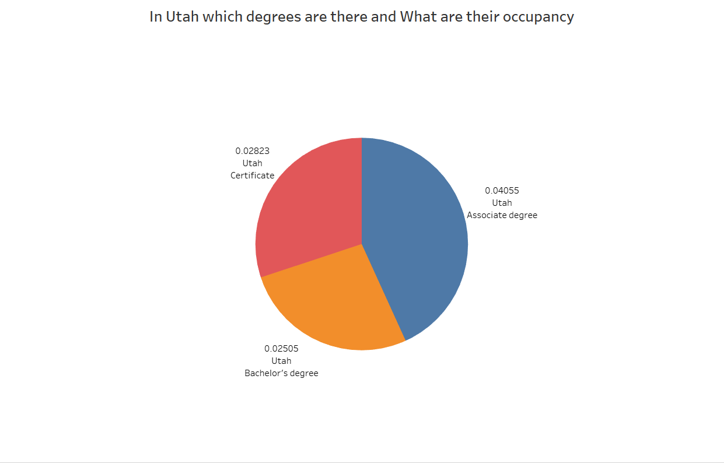
4.In Utah state which degree has the highest average.
Ans: Associate degree

Slide 8
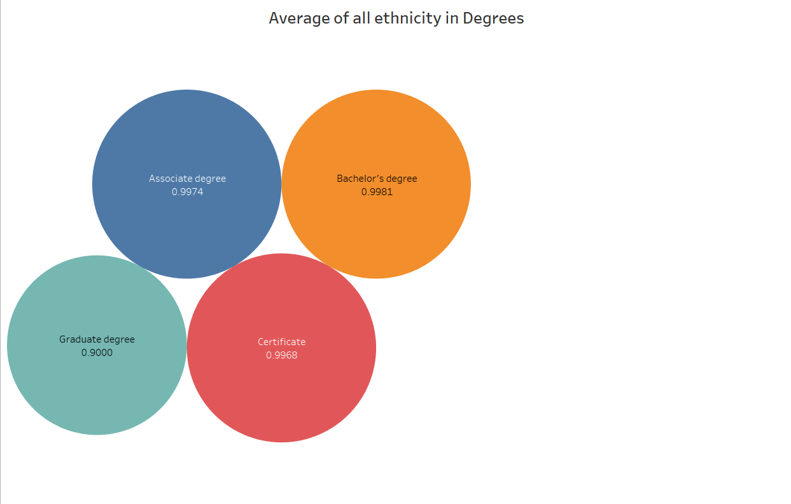
5.Which degree is highest Among all ethnicity aggregate with PREDDEG
Ans: 0.9981

Slide 9
Conclusion
As a result of the current analysis, it became evident that California was going to lead for the number of entries for public-controlled institutions, which meant that accessible higher education was highly concentrated there. Moreover, one of the most surprising trends among Hispanic students was the fact that private for-profit institutions had the highest average, meaning that there were certain enrollment practices or kinds of community outreach that had to be investigated.
The analysis of racial demographics presented a pretty diverse student enrolment across the institutions, with percentages of different racial backgrounds varying greatly. The predominate type of awarded degree analysis across states presented particularly interesting results, highlighting the trends like New-York’s focus on Bachelor’s degrees or Utah’s focus on Associate degrees.

Slide 10

Thank You

